Slide 1
Introducing Data Visualization & Power BI

Slide 2
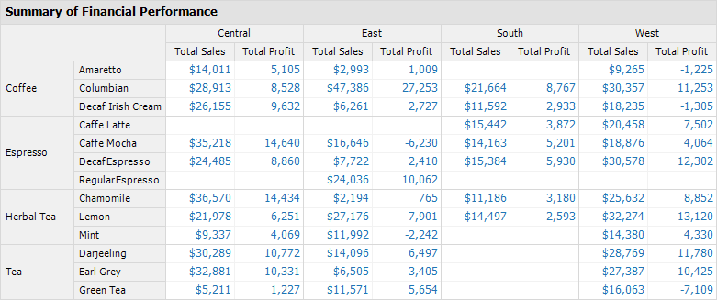
Visualization 1
The Pivot Table view is useful for looking up the precise performance of a specific product.

Slide 3
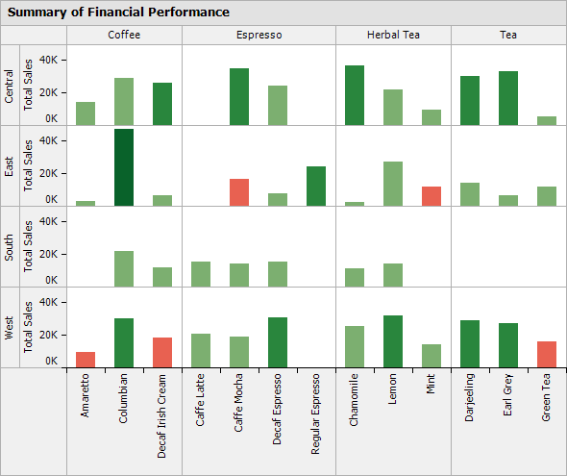
Visualization 2
Graphical view is useful for examining relative magnitudes, relationships and anomalies.
For instance, it clearly shows the areas of the business resulting in negative profit (red bars).

Slide 4
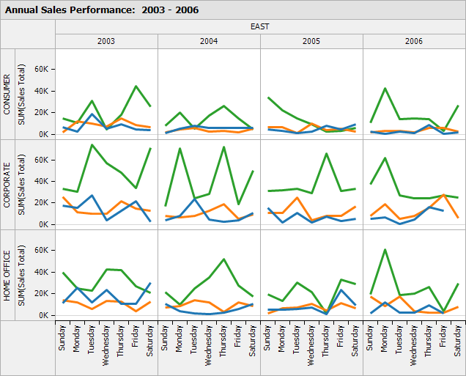
Visualization 3
Shows day-wise within each year sales in each region for each product type.
“What is the peak sales weekday for each product in each segment in each year?”

Slide 5
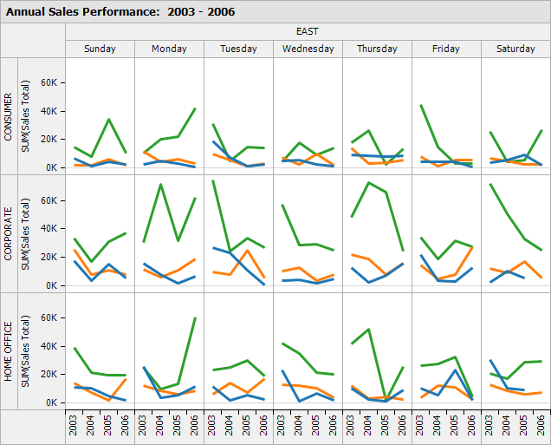
Visualization 4
“Year to year, have Saturday sales been improving or worsening for each product in each segment?”
In Data Visualization tools, users can toggle between these visualizations with one click.

Slide 6
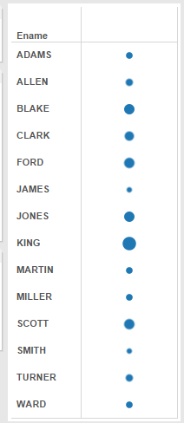
Visualization 5
Salary is put in Size property.
As King has highest salary the circle of King is the biggest!

Slide 7
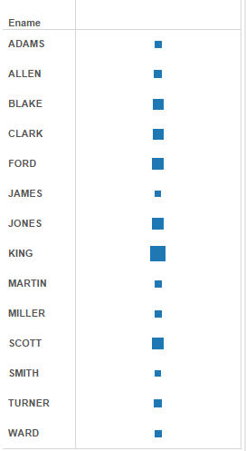
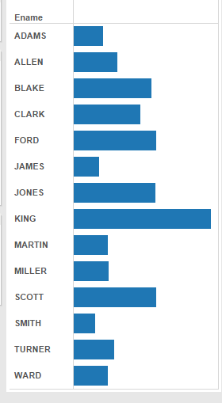
Visualization 6

Slide 8


Slide 9


Slide 10


Slide 11


Slide 12
Dashboard
The ultimate thing →

Slide 13
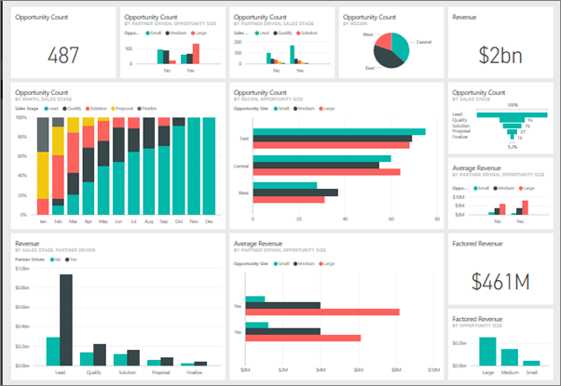
Dashboard

Slide 14
Background of Power BI – Part 1
Excel had 4 add-ins/ features, namely
Power Pivot
Power Query
Power View
Power Map

Slide 15
Background of Power BI – Part 2
The real problem →
It was becoming very much difficult to Microsoft to manage this, because with every new version of Excel these 4 add-ins had to be managed.
Plus let’s consider an scenario where user A is working on Excel 2016 with the 4 add-ins and user B is working with Excel 2010. Now user A sends the file created using those add-ins to user B then it work differently in user B machine. It was creating big issue.
Hence Microsoft came with a separate application known as Power BI.

Slide 16
Background of Power BI – Part 3
Power Pivot
+
Power Query
+
Power View
+
Power Map
=
Power BI

Slide 17
What is Power BI? – Part 1
Power BI is a collection of software services, apps, and connectors that work together to turn your unrelated sources of data into coherent, visually immersive, and interactive insights.
Whether your data is a simple Excel spreadsheet, or a collection of cloud-based and on premises hybrid data warehouses, Power BI lets you easily connect to your data sources, visualize (or discover) what’s important, and share that with anyone or everyone you want.

Slide 18
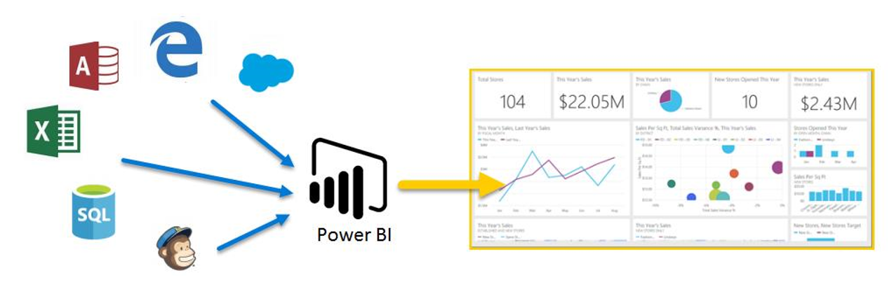
What is Power BI? – Part 2

Slide 19
What is Power BI? – Part 2

Slide 20
What is Power BI? – Part 2

Slide 21
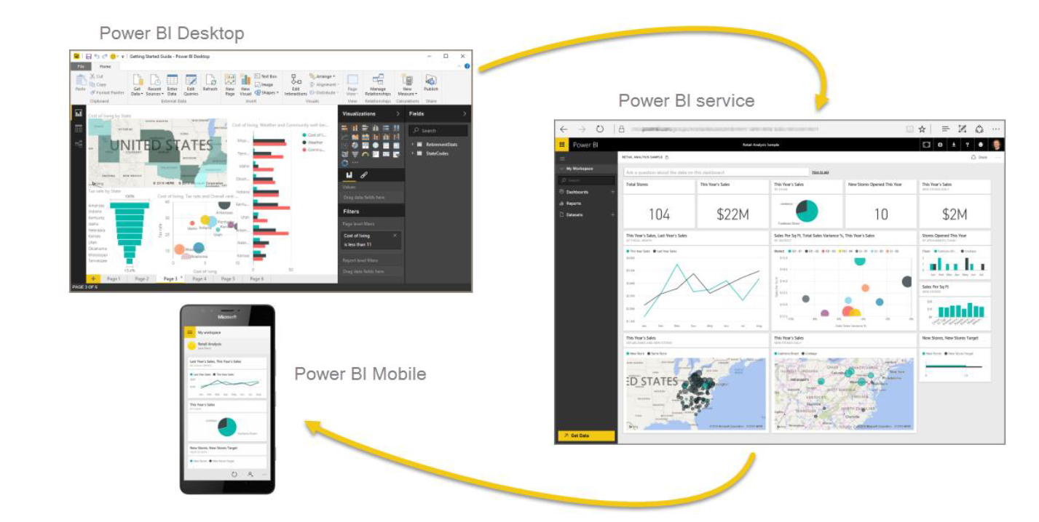
Types of Products in Power BI

Slide 22
Types of Products in Power BI

Slide 23
Types of Products in Power BI

Slide 24
Types of Products in Power BI

Slide 25
Power BI Desktop
This is the version that we have installed. It can be also said as offline version.
Power BI Desktop is a free application you can install on your local computer that lets you connect to, transform, and visualize your data.

Slide 26
Power BI Service
It s a cloud-based business analytics service that allows us to conceive and interpret data with a higher rate, performance, and intelligence.
The dashboards created using Power BI Desktop are published in Power BI Service. Actually you are publishing it on web. Then you do not need Power BI to see those dashboards!
*****Power BI Account → You need the Power BI user accounts for publishing your reports in Power BI Service. *****

Slide 27
Power BI Mobile
Power BI offers a set of mobile apps for iOS, Android, and Windows 10 mobile devices.
All these reports and dashboards are available in the Power BI mobile apps, whether they're on premises or in the cloud.

Slide 28


